Slide 1
P1:Obesity Prediction
Machine Learning and Deep Learning Project
By Group6
Albert Zeng & Eleanor Ma & Sharifa Esfandiari
2023-10-12

Slide 2
AGENDA
Objectives
Data Source
Exploratory Analysis
Preparation for Model Training
Different Model Performance
Model Evaluation
Conclusion

Slide 3
Objectives
Business Problem: Improve Health Assessment and Risk Prediction, Obesity and related health issues pose significant risks to individuals. Early identification and intervention can lead to better health outcomes and reduced healthcare costs.
Technical Problem: Create a machine learning model for Weight Classification, choose appropriate machine learning algorithms for weight classification, use the dataset, and optimize hyperparameters to improve model performance. Employ cross-validation to assess model robustness and generalization. Finally assess model performance using various metrics such as accuracy, precision, recall, F1-score, and ROC-AUC. Analyze ROC-AUC curves and precision-recall curves to understand model behavior and trade-offs.

Slide 4
Data Source
Columns | Description
Gender | The gender of the individual (e.g., Male or Female)
Age | The age of the individual
Height | The height of the individual in meters
Weight | The weight of the individual in kilograms
family_history_with_overweight | Indicates whether there is a family history of overweight (e.g., yes or no)
NCP (Number of Main Meals per Day) | Indicates the number of main meals the individual consumes per day
CAEC (Consumption of Food Between Meals) | Indicates the consumption of food between meals (e.g., Always, Frequently, Sometimes, or No)
SMOKE | Indicates whether the individual smokes (e.g., yes or no)
FAF (Physical Activity Frequency) | Indicates the frequency of physical activity
MTRANS (Mode of Transportation) | Indicates the mode of transportation used by the individual (e.g., Walking, Public Transportation, etc.).
NObeyesdad (Obesity Level) | Indicates the obesity level of the individual
… | …
Data downloaded from UCI:
https://archive.ics.uci.edu/dataset/544/estimation+of+obesity+levels+based+on+eating+habits+and+physical+condition
2111 rows and 17 columns
Various features related to obesity characteristics, including physical and health related information about the sample individuals.

Slide 5
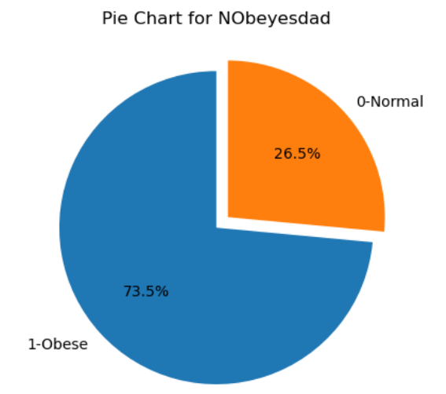
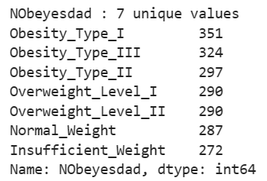
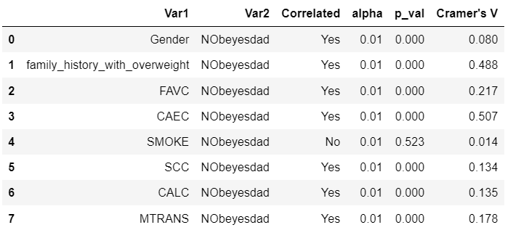
Dataset Modifications
The original target variable “NObeyesdad” has 7 categories
Categories are defined by calculating BMI*:
BMI = Weight / Height^2
“Weight” feature will be removed
Recategorize target classes into “Normal” class and “Overweight/Obese” class
Chi-Square Test against target:
“SMOKE” is not correlated with the target variable at a 0.01 significant level
“SMOKE” feature will be removed
* https://doi.org/10.1016/j.dib.2019.104344

Slide 6
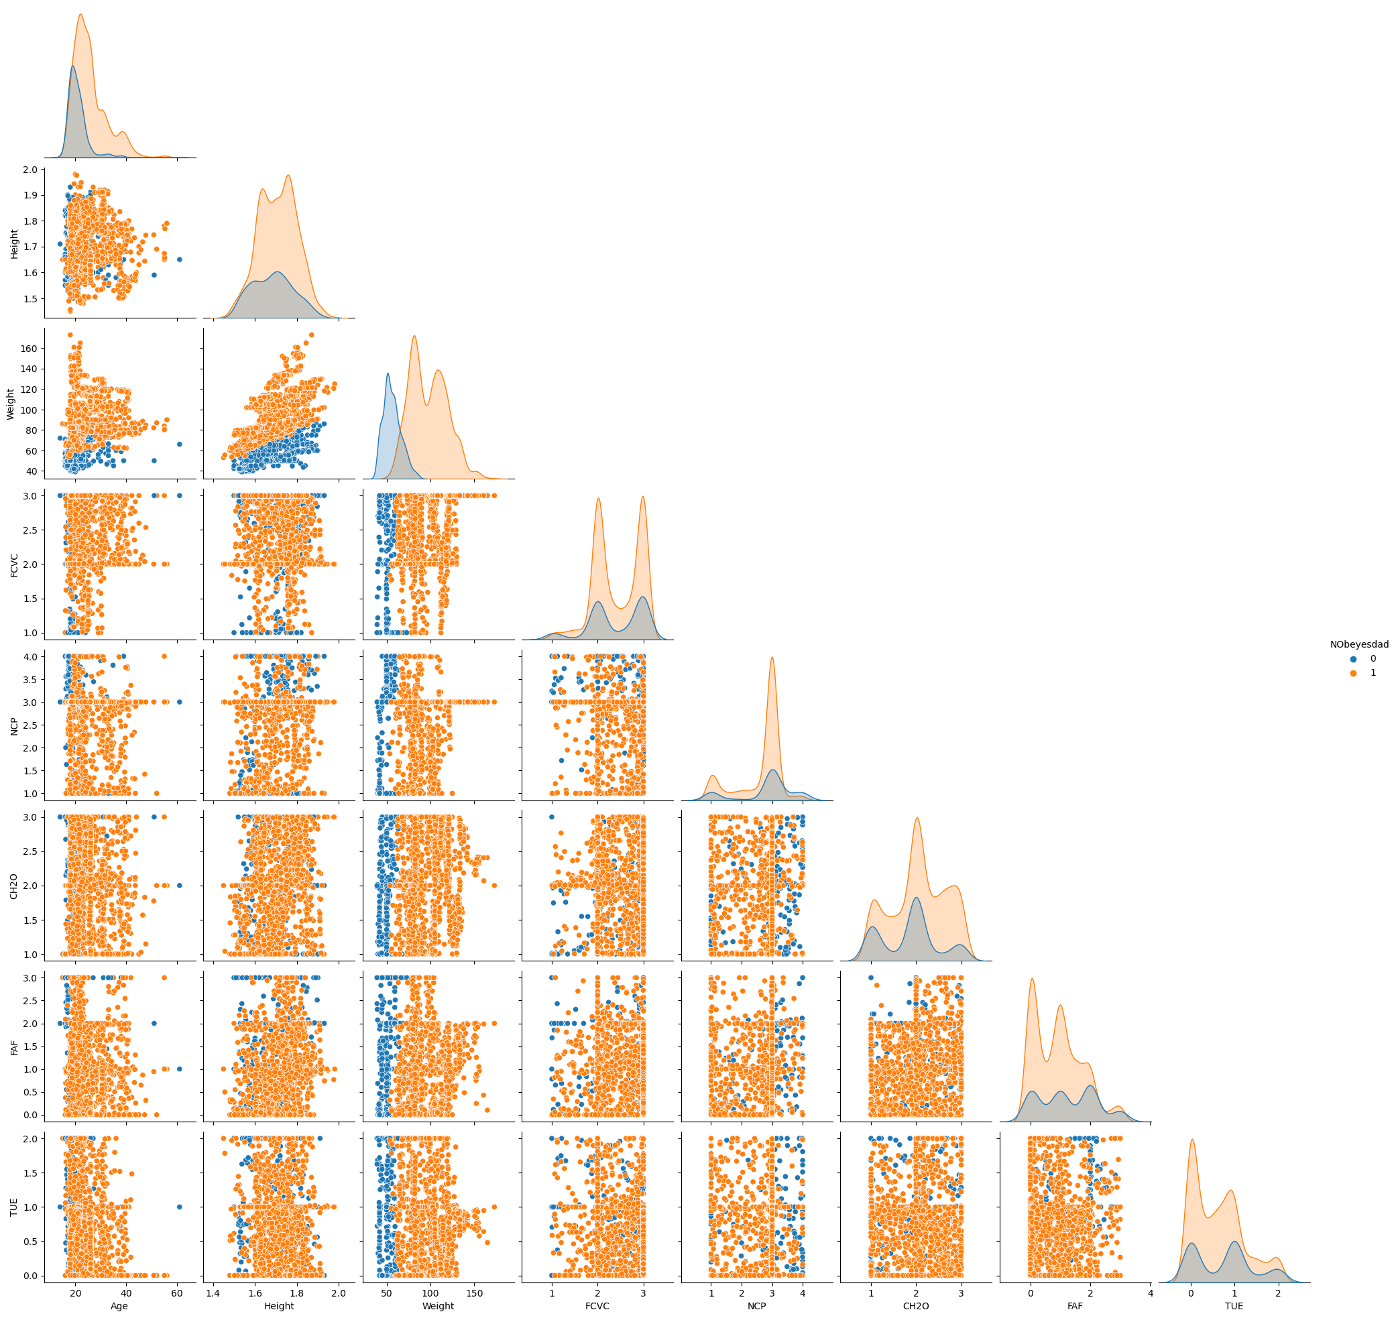
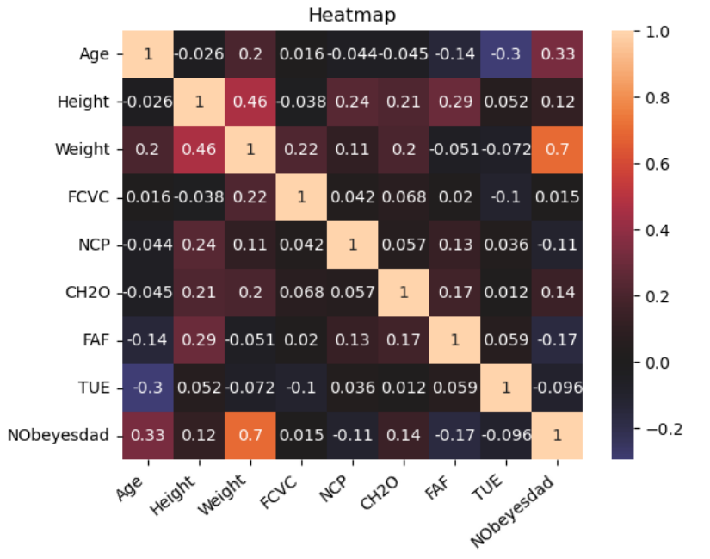
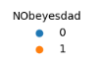
Exploratory Analysis
High correlation between weight (removed) and target variable

Slide 7
Preparation for Model Training
Encoding
Split Training and Testing Set
Scaling
Outliers
Removing columns ‘Weight’ and ‘SMOKE’
Assign numeric labels to columns 'Gender', ‘family_history_with_overweight', 'FAVC‘, 'SCC’, 'CAEC’, 'CALC’
Encode column ’MTRANS’
Using 0.25 test set proportion
‘Nobeyesdad’ is an imbalanced target，stratify=y
MinMaxScaler method on X, most of the variables are either discrete or between a small range
Scaled data only used by some models (DT, RF use unscaled data)
We can find there are no extreme outliers.

Slide 8
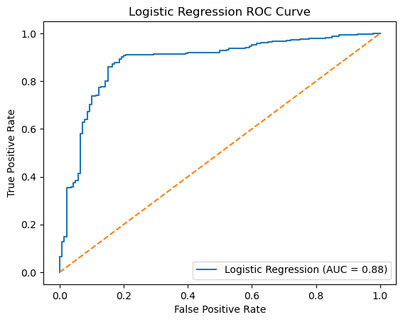
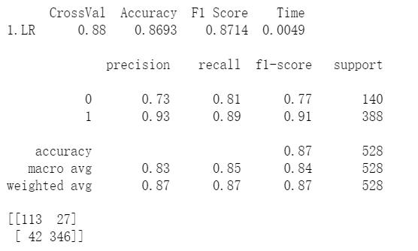
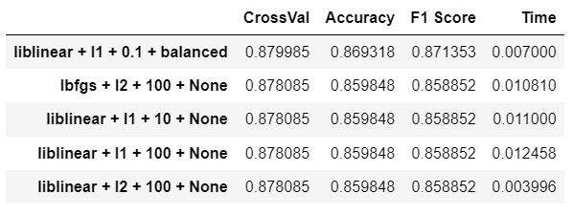
Different Model Performance
Model 1 –LogisticRegression
Parameters: solver = ['lbfgs','liblinear’; 'liblinear’]; penalty = ['l2','l1','l2’];
C = [.01,.1,1,10,100]; class_weight = [None,'balanced’]
Best LogisticRegression Parameters：solver='liblinear', penalty='l1', C=0.1, class_weight='balanced’
When evaluating the hyperparameters, we prioritize f1 score over accuracy because the target classes are imbalanced.
LR Top 5 Parameters Result
Best LogisticRegression
ROC curve and AUC score

Slide 9
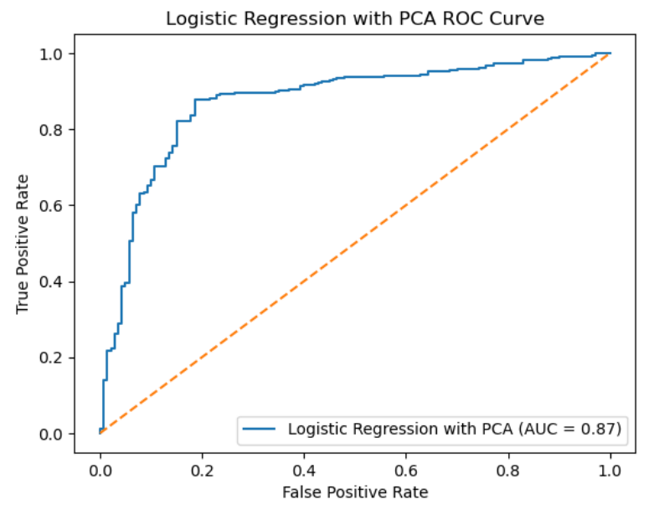
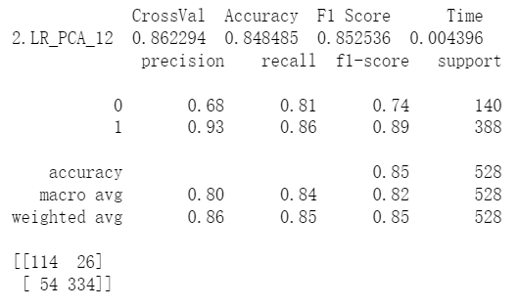
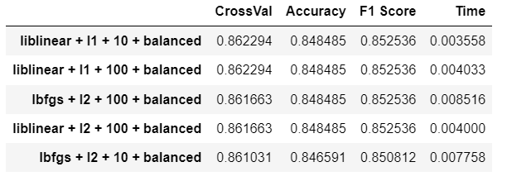
Different Model Performance
Model 2 – LogisticRegression with PCA，selection 12 features
Parameters: solver = ['lbfgs','liblinear’; 'liblinear’]; penalty = ['l2','l1','l2’];
C = [.01,.1,1,10,100]; class_weight = [None,'balanced’]
Best LogisticRegression with PCA Parameters：solver='liblinear', penalty='l1', C=10, class_weight='balanced'
PCA Top 5 Parameters Result
Best LogisticRegression with PCA
ROC curve and AUC score

Slide 10
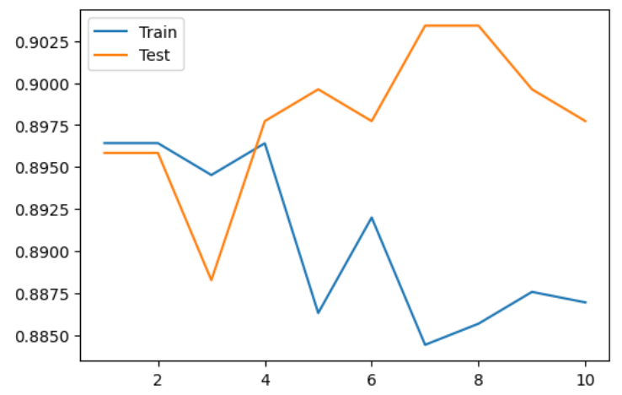
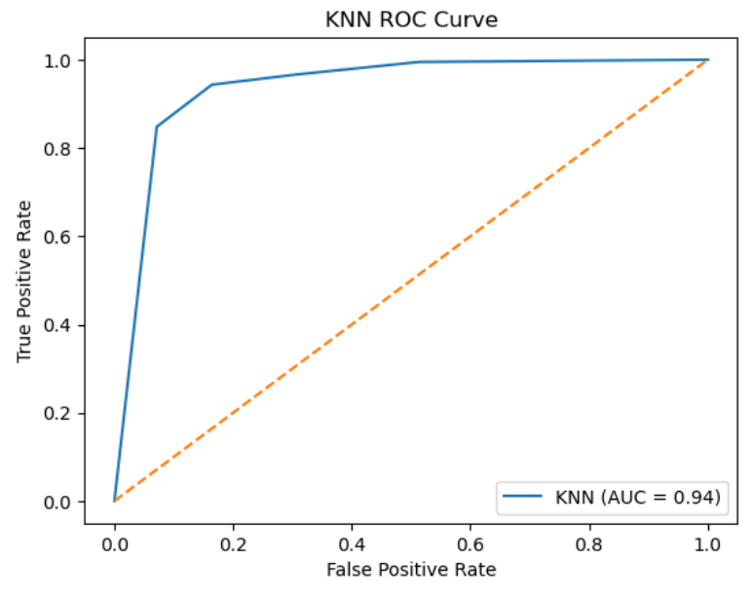
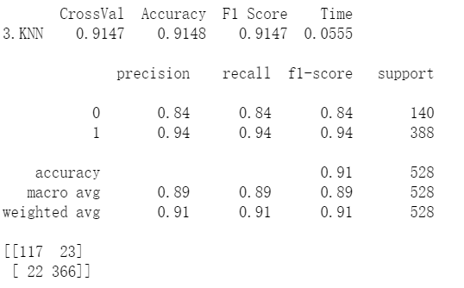
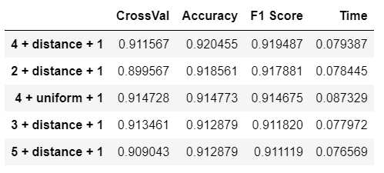
Different Model Performance
Model 3 – K-Nearest Neighbors
Parameters: n_neighbors = [2,3,4,5]; weights = ['uniform','distance’]; p = [2,1]
Best K-Nearest Neighbors Parameters：n_neighbors=4, weights='uniform', p=1
KNN Top 5 Parameters Result
Best KNN classifier
ROC curve and AUC score
n_neighbors will try 2,3,4,5

Slide 11
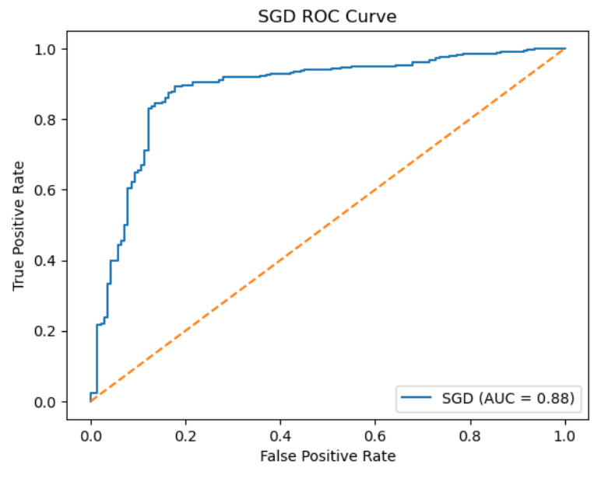
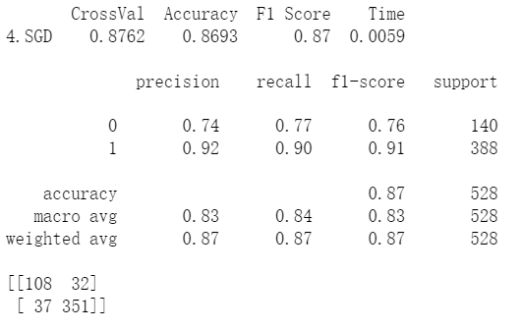
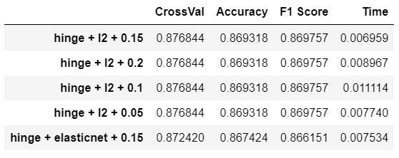
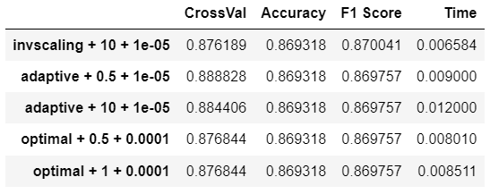
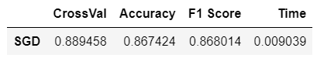
Different Model Performance
Model 4 – Stochastic Gradient Descent (SGD)
Selection RandomizedSearchCV Parameters：{'penalty': 'elasticnet', 'loss': 'hinge', 'learning_rate': 'adaptive', 'l1_ratio': 0.15, 'eta0': 0.5, 'alpha': 0.0001}
Parameters: loss = [‘hinge’,‘log_loss’,‘modified_huber’,‘perceptron‘]，penalty =[’l2’,‘l1’,‘elasticnet’,None]，l1_ratio = [.15,.2,.1,.05] ，learning_rate = [‘optimal’,‘adaptive’,‘invscaling‘]，eta0 = [.5,1,10]，alpha = [.0001,.001,.00001]
SGD RandomizedSearchCV Result
SGD param1,2,3 Result
SGD param4,5,6 Result
Best Stochastic Gradient Descent
ROC curve and AUC score

Slide 12
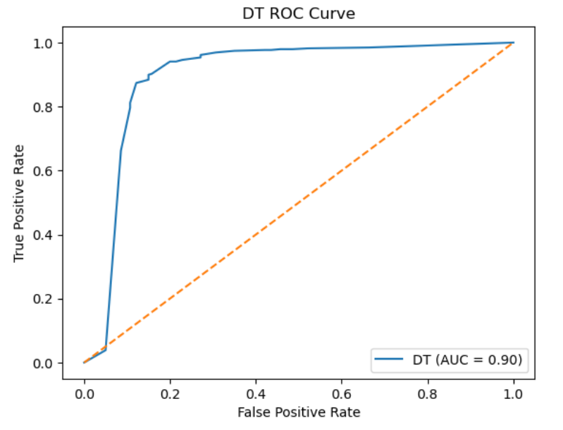
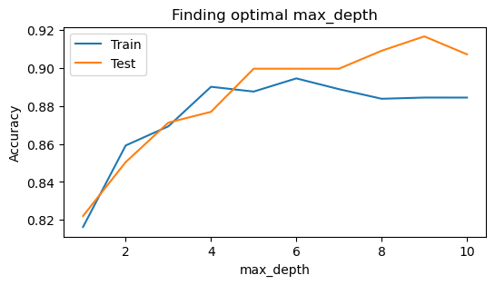
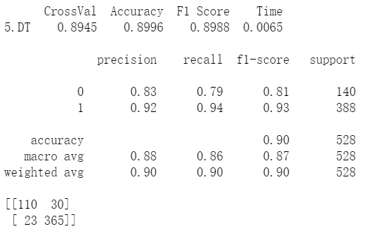
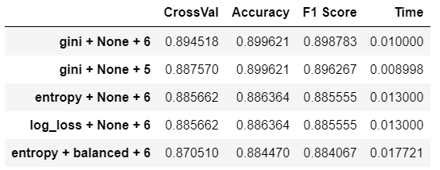
Different Model Performance
Model 5 – Decision Tree Classifier
Parameters: criterion = ['gini','entropy','log_loss‘]; class_weights = [None,'balanced’]; max_depth = [4,5,6]
Best Decision Tree Classifier parameters: criterion=‘gini’, max_depth=6
DT Top 5 Parameters Result
Best Decision Tree Classifier
ROC curve and AUC score
Max_depth will try 4,5,6

Slide 13
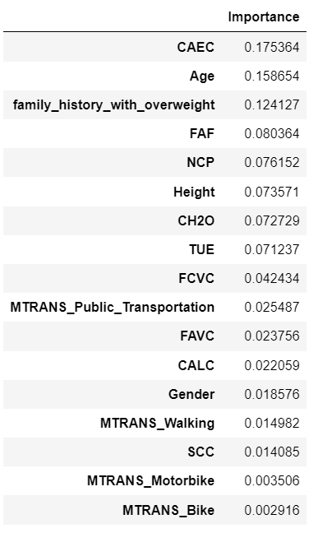
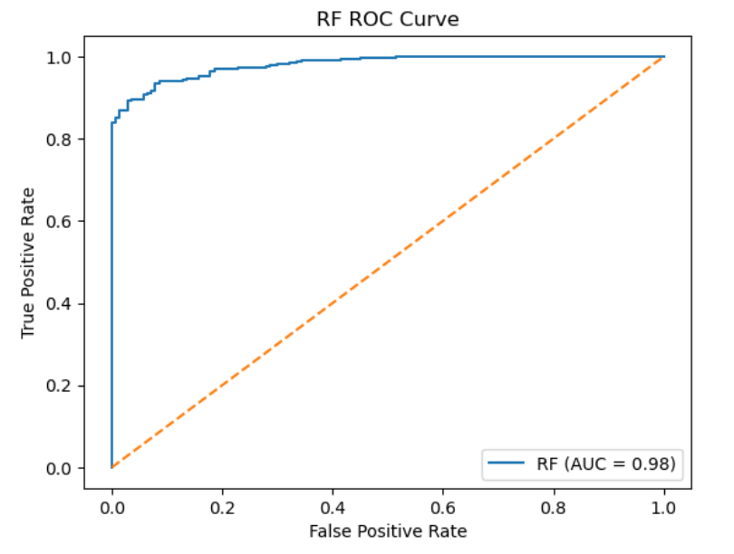
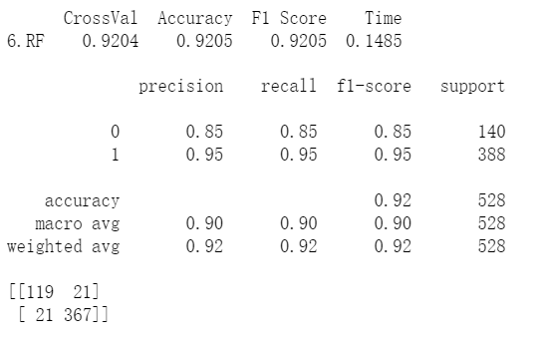
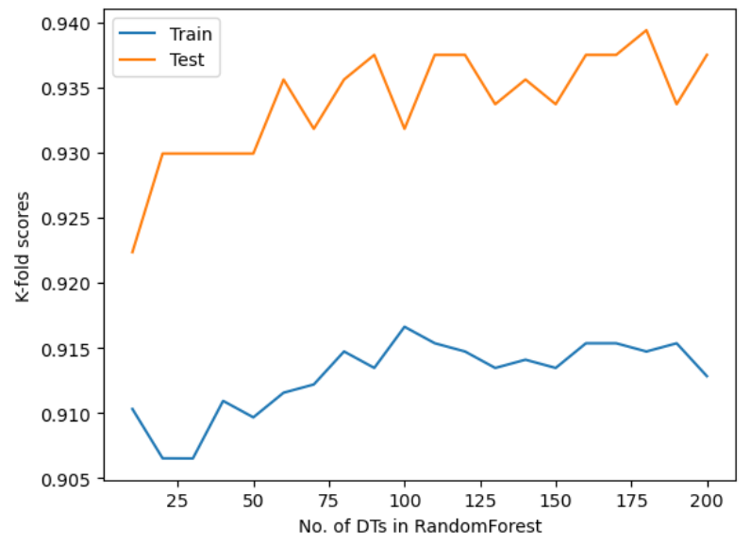
Different Model Performance
Model 6 – Random Forest
Selection RandomizedSearchCV Parameters： 'n_estimators':[100,90,80], 'criterion':['gini','entropy','log_loss'], 'max_depth':[None,20,40,60], 'max_leaf_nodes':[None,10,20,30], 'min_samples_split':[5,8,10], 'max_features':['sqrt',3,5,6]}
Best Random Forest Parameters：n_estimators=90, criterion='gini', max_depth=60, max_features=3, min_samples_split=5
There is a consistent pattern of having higher test score than train score. This indicates an underfit and hyperparameter will be tuned to avoid this.
Best Random Forest Result
ROC curve and AUC score
Feature Importance

Slide 14
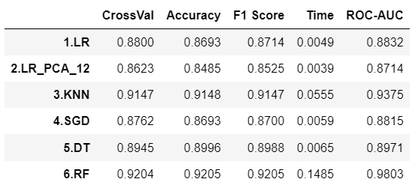
Model Evaluation
From the ROC-AUC score we can conclude that model 6 using the Random Forest method was the best model for this prediction, with a ROC-AUC score of 0.98 and F1 score of 0.92.
However model 6 is also the most time-consuming model, spending 0.15 seconds on fitting and predicting, about 30 times slower than logistic/SGD/DT models
The second best performing model is model 3 with KNN method, with a ROC-AUC score of 0.94 and F1 score of 0.91. It is also more time-consuming compared to other models.

Slide 15
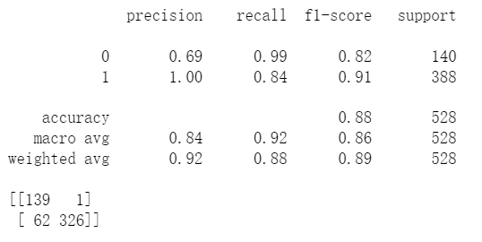
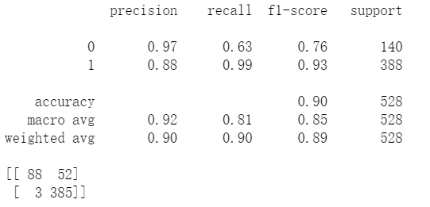
Model Evaluation
If the goal of the project is to correctly identify either all the normal or all the obese groups, the threshold of the binary classification can be adjusted for each case:
To identify all the normal groups with 99% recall rate, the threshold can be set to 0.8
To identify all the obese groups with 99% recall rate, the threshold can be set to 0.3
Threshold at 0.8:
Group 0-normal with 99% recall rate
Threshold at 0.3:
Group 1-obese with 99% recall rate

Slide 16
Conclusion
To predict whether an individual is normal or overweight/obese based on the individual’s health-related attributes, while not knowing the weight of the individual.
The best model constructed was using the Random Forest ensemble method:
F1 score of 0.92
0.85 recall score on the normal class
0.95 recall score on overweight/obese class
The five most important features related to obesity:
1. Consumption of food between meals
2. Age
3. Family history with overweight
4. Physical activity frequency
5. Number of main meals

Slide 17
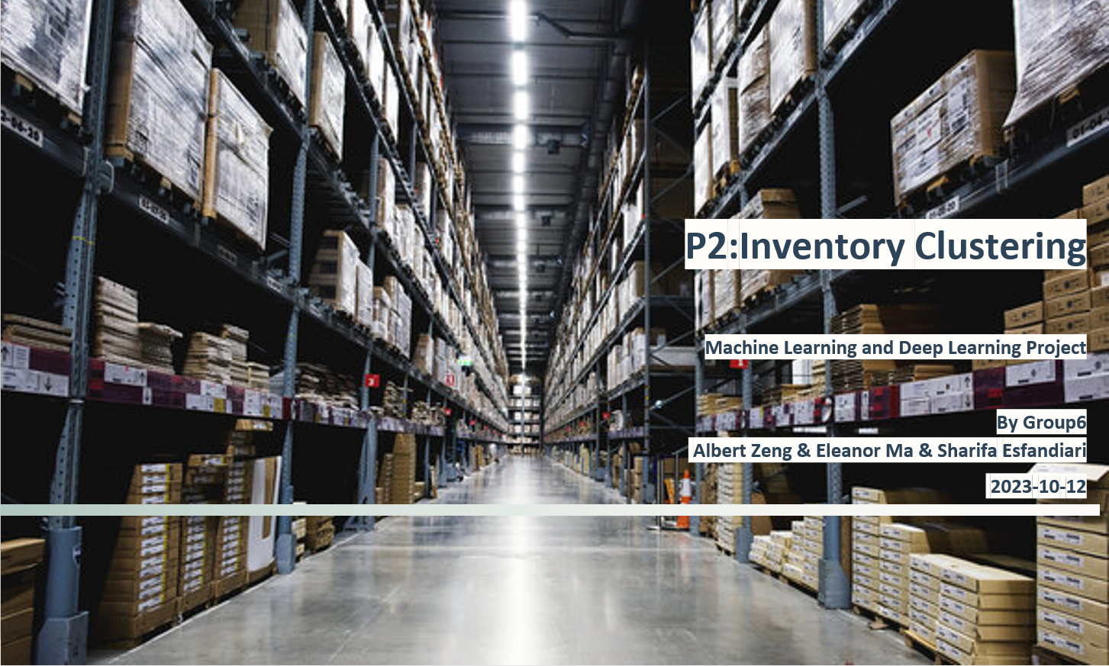

Slide 18
AGENDA
Objectives
Data Source
Exploratory Analysis
Clustering
Model Evaluation
Conclusion

Slide 19
Objectives
Product Segmentation: To categorize products (SKUs) into meaningful clusters based on attributes, including unit price, expiration date, outbound metrics, and pallet-related features. This segmentation will reveal natural groupings and enable a deeper understanding of product behavior within the inventory.
Pattern and Behavior Analysis: Creating distinct clusters, uncover patterns and behaviors among products. Guide decision-making processes related to marketing strategies, inventory management, pricing, and sales strategy, ultimately leading to more informed and data-driven business strategies.

Slide 20
Data Source
Columns | Description
ID | Unique identifier for each product
Unitprice | The unit price in euro
Expire date | The shelf-life days of the product
Outbound number | Number of orders on this product
Total outbound | Number of pallets sold
Pal grossweight | Gross weight of a fully-loaded pallet in kg
Pal height | Height of a fully-loaded pallet in cm
Units per pal | The number of units of the product on a pallet
Data downloaded from UCI:
https://archive.ics.uci.edu/dataset/585/stock+keeping+units
2279 rows and 8 columns
Various features related to inventory management that can be utilized by a classical ABC analysis. The dataset is gathered for the period 2017-02-06 to 2018-02-13.

Slide 21
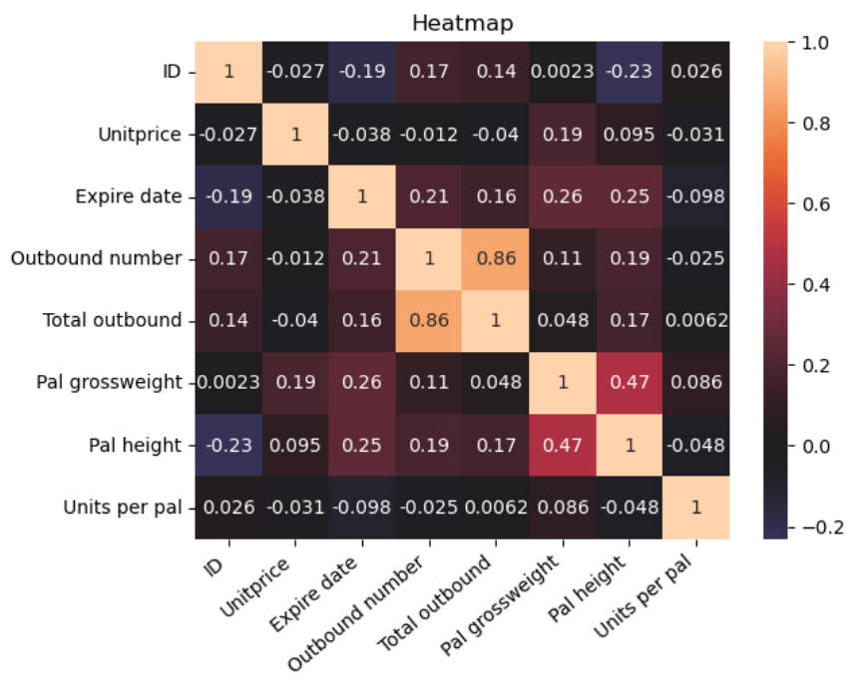
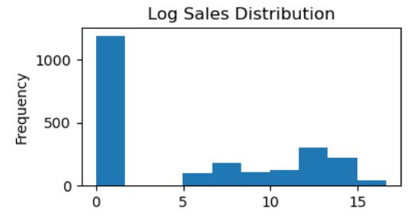
Exploratory Analysis
Based on basic data, Cleaning and Transformation, including “0 duplicated” “0 na”
Create “Sales = 'Unitprice' * 'Units per pal'* 'Total outbound’” ,Log transformation on Sales
Convert “Outbound number into Avg_Order_Pal = 'Total outbound'/ 'Outbound number’”, the high correlation between Outbound number and Total outbound. After converting, the new feature correlation with Total outbound was dropped to 0.07 from 0.86
Using StandardScaler method on data

Slide 22
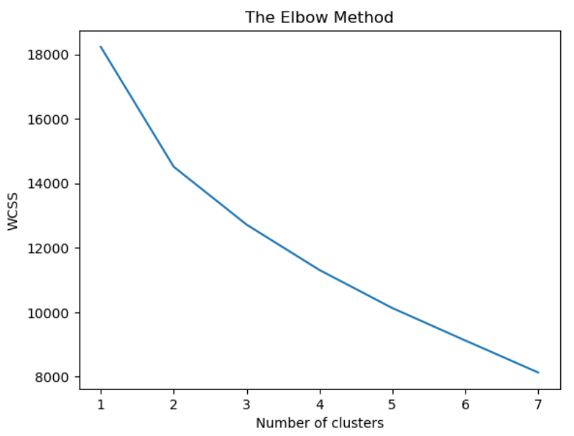
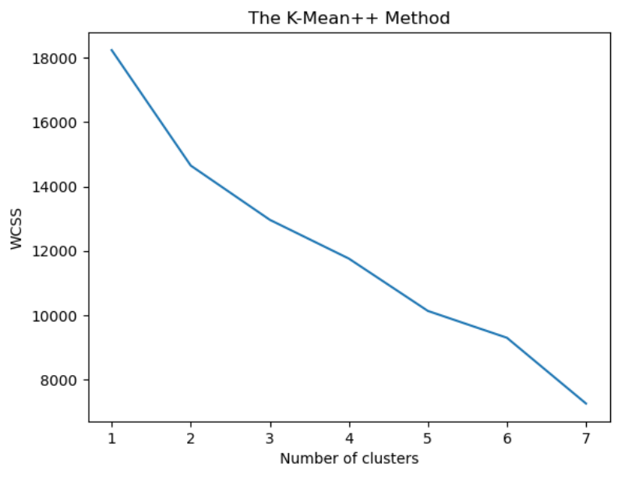
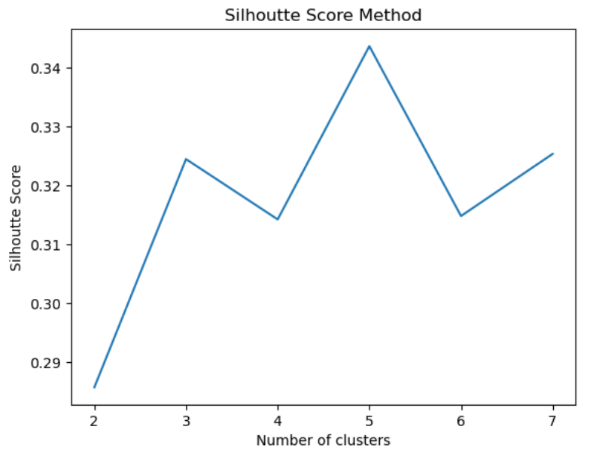
Clustering
Trying different ways to find a suitable cluster
Method 1 –Elbow; Method 2 –K-Mean++; Method 3 –Silhoutte score
The Elbow and K-Mean++ method could not find a good diminishing return point in WCSS
The Silhoutte score method shows there is a local maximum at 3 and 5 clusters
5 cluster seems to be the better options here as the Silhoutte score would be higher and WCSS would be lower, but in terms of reducing complexity for business understanding, 3 was chosen to be the number of clusters

Slide 23
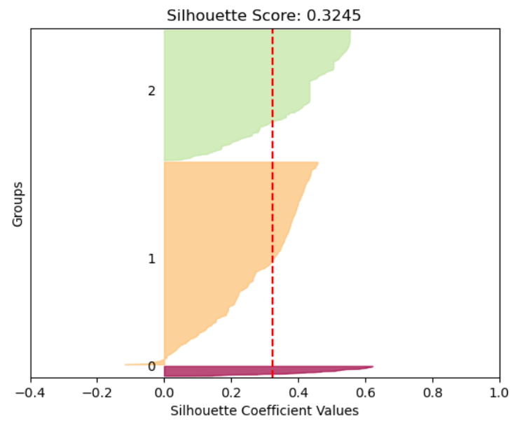
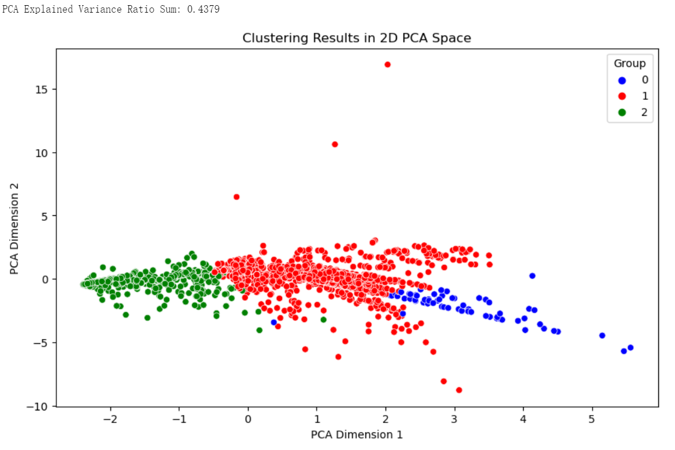
Clustering
Confirm the validity of the cluster
Method 1 –silhouette coefficient; Method 2 –PCA 2 dimensions
The silhouette coefficient value 0.3245 can still be acceptable
The PCA 2 dimensions method shows clear 3 clusters
PCA explained variance Ratio is 0.4379, will reducing the dimensionality of the data

Slide 24
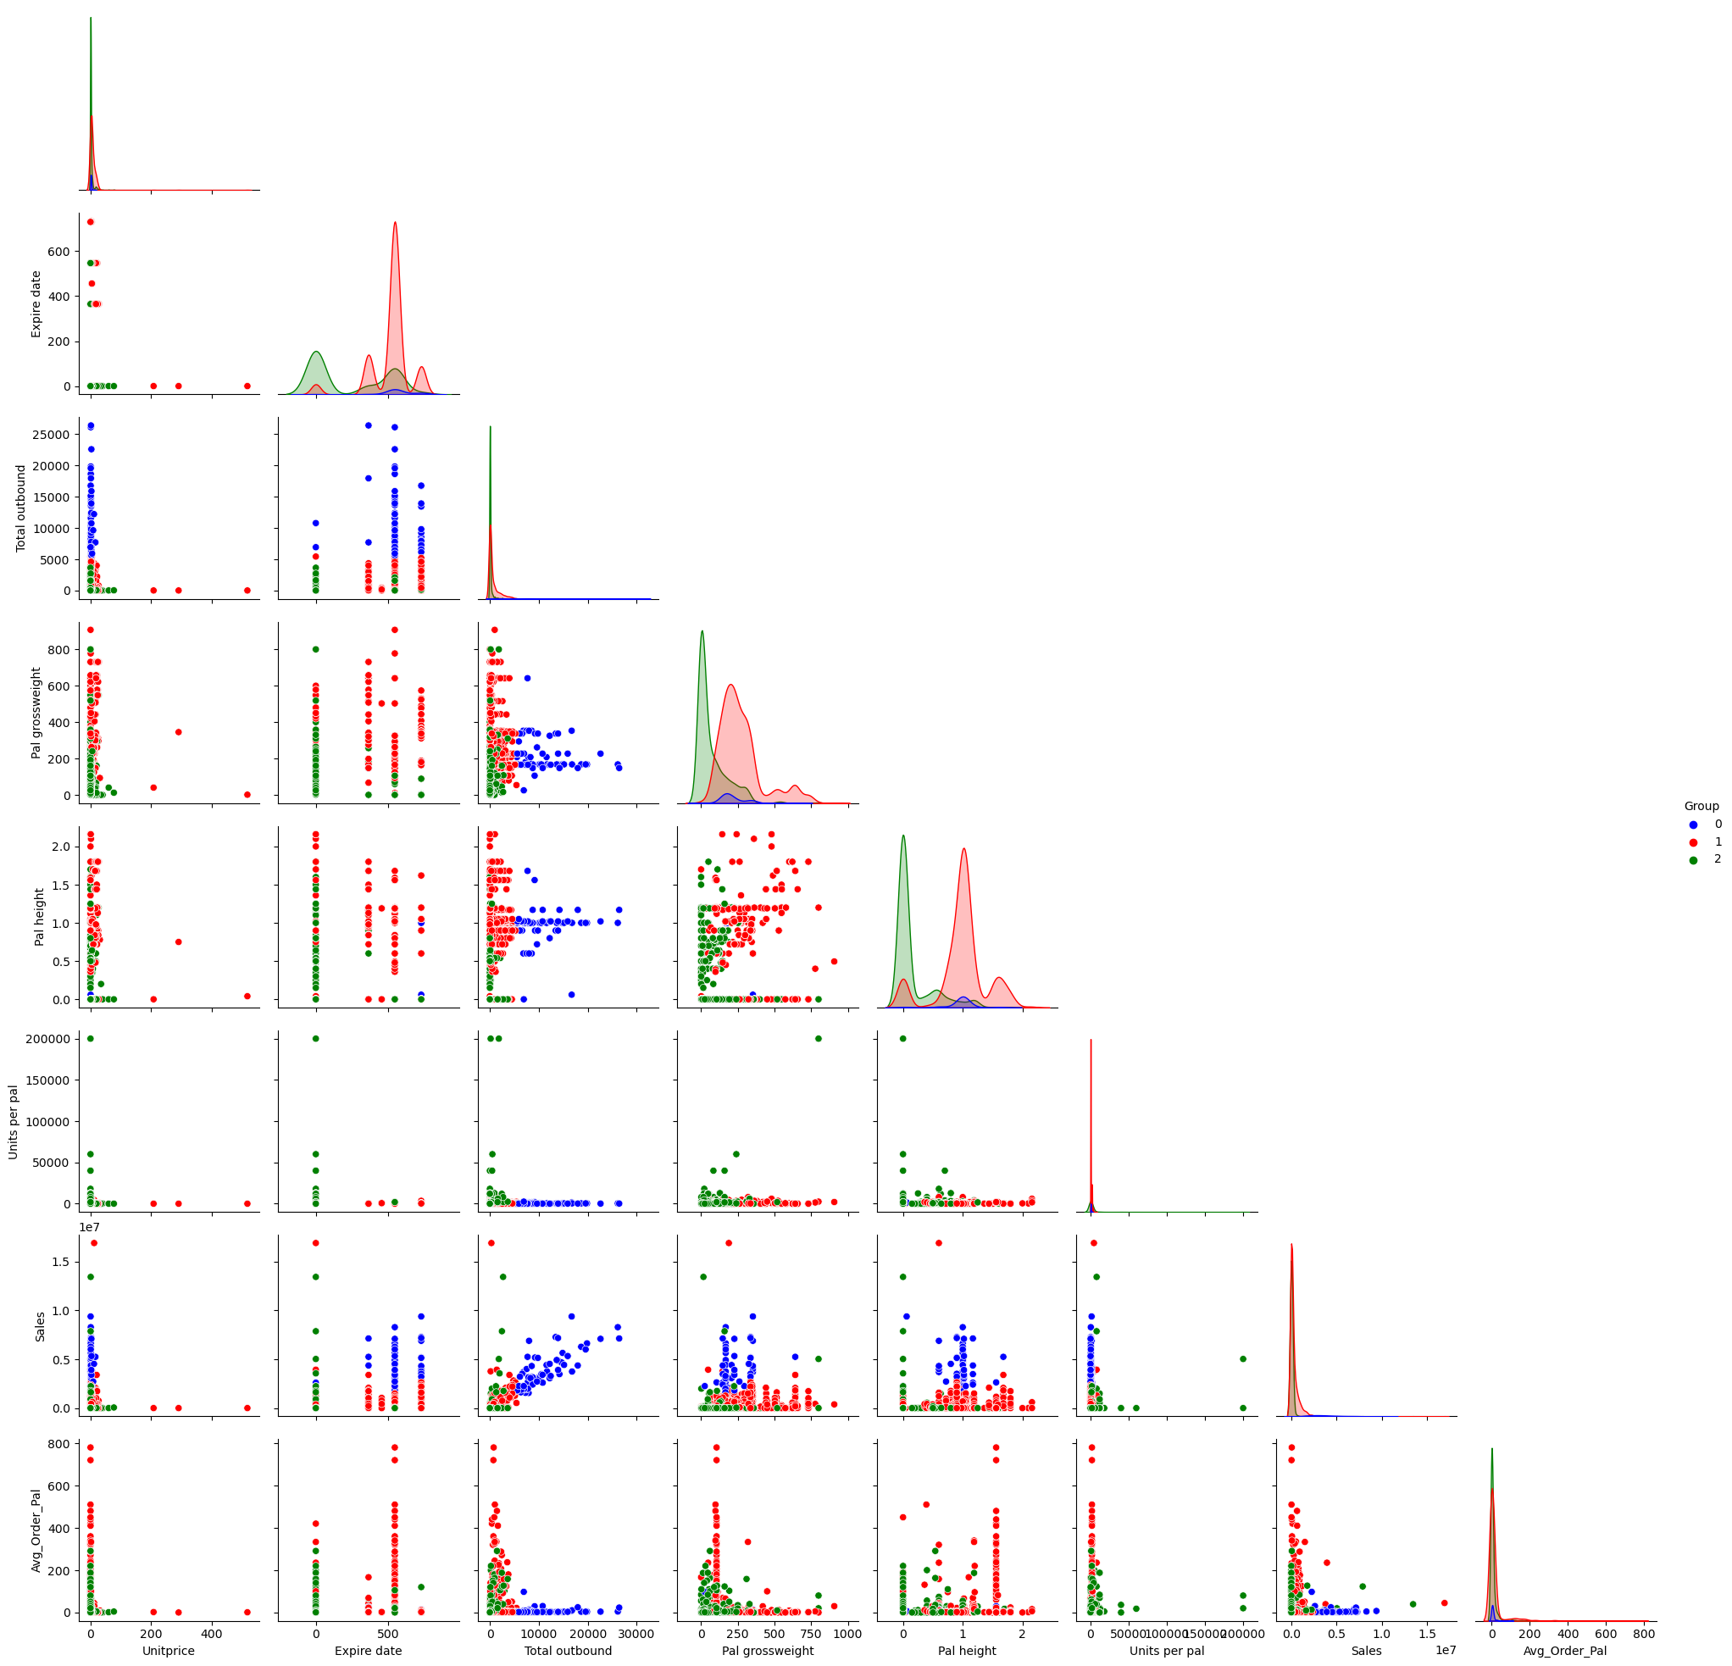
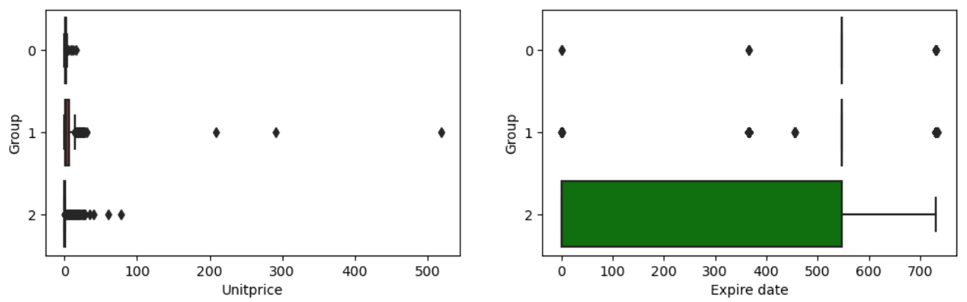
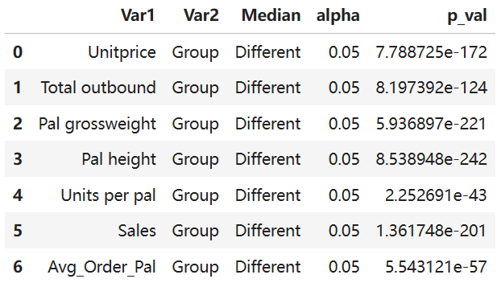
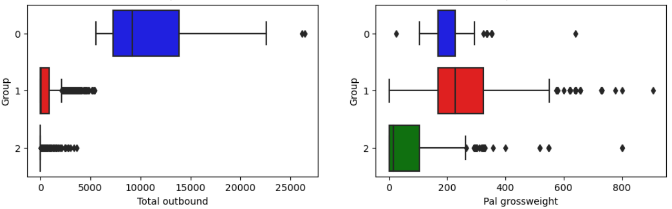
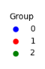
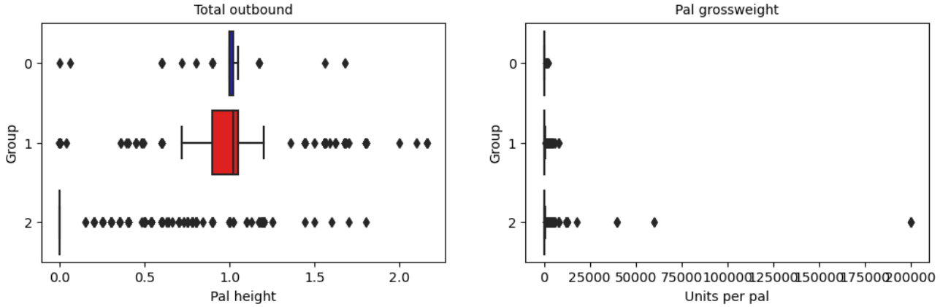
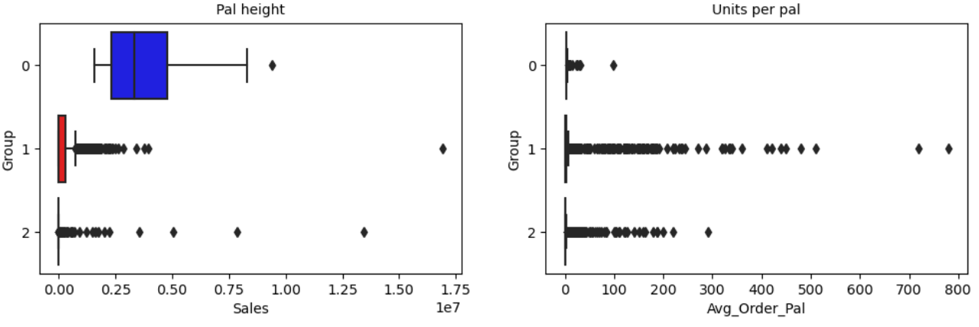
Model Evaluation
Kruskal-Wallis Test performed against Group
All features show independence relationship with Group

Slide 25
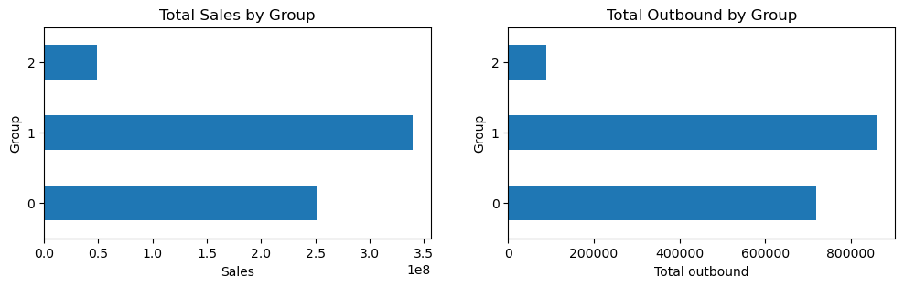
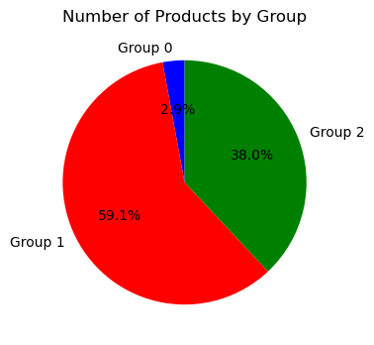
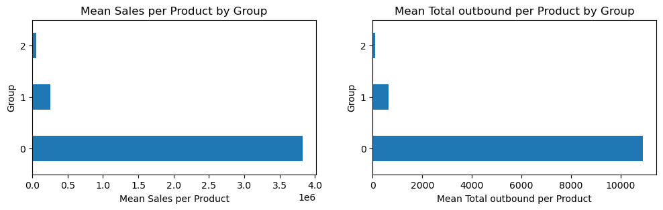
Model Evaluation
The grouping was based on total 8 different attributes of the products. Some clear trends can be seen from the grouping:
Group 0 - high sales value, high outbound per product, high expire date, low unit price, 66 products in this group
Group 1 - high sales value, low outbound per product, high expire date, high unit price, 1347 products in this group
Group 2 - low sales value, low outbound per product, low expire date, low unit price, 866 products in this group

Slide 26
Conclusion
Inventory products were assigned into 3 different clustering groups, using handling and turnover features that are essential in an classical ABC inventory analysis. This segmentation provides a foundation for tailored marketing strategies and product offerings
Group 0 is similar to class A category in ABC analysis, where a few products contributes to large proportion of sales with high turnover rate. Customers tend to purchase these products in larger quantities and may be interested in bulk or wholesale deals
Group 1 is similar to class B category, where most of the products fall into and contribute to some proportion of sales. Customers for these products are likely to be price-sensitive and prefer lower-priced items
Group 2 is similar to class C category, where the products are not contributing much to sales and have low usage in general
In conclusion, leveraging clustering analysis enables us to drive data-informed decisions that align with customer preferences, enhancing marketing, customer experiences, and inventory management for overall project success.

Slide 27
Thanks

